Slide 1

JENSONUSA
SQL Analysis
Presented by :
Gowri Abbigeri

Slide 2

About Company
Jenson USA began in 1994 with a simple idea: to bring quality bikes and cycling gear to riders who share the joy of being on the trail, the road, or anywhere a bike can take them.
Over the years, the company has grown into a well-known cycling retailer with a wide online store and welcoming retail locations. Their team is made up of passionate riders who understand what cyclists need — because they ride too.
Whether someone is gearing up for their first ride or fine-tuning a race bike, Jenson USA delivers expert guidance, top-brand products, and a supportive community built on the love of riding.

Slide 3
OUR OBJECTIVE
ANALYZE CUSTOMER BEHAVIOR
Understand purchasing patterns, customer preferences, and spending habits to identify key customer segments and improve personalization strategies.
EVALUATE STAFF PERFORMANCE
Measure sales contribution by individual staff members, identify top performers, and opportunities for training or performance improvement.
OPTIMIZE INVENTORY MANAGEMENT
Track product sales over time, identify top-selling and unsold items, and support data-driven inventory restocking and clearance decisions
ENHANCE STORE OPERATIONS
Compare performance across different store locations by analyzing order volume, product movement, and customer engagement to support operational efficiency.
IDENTIFY HIGH-VALUE PRODUCTS AND CATEGORIES Determine products and categories contributing most to revenue to inform promotional strategies and inventory focus.
SUPPORT STRATEGIC DECISION MAKING
Provide actionable insights to management for improving sales, customer satisfaction, and overall business performance using reliable, data-driven analysis

Slide 4
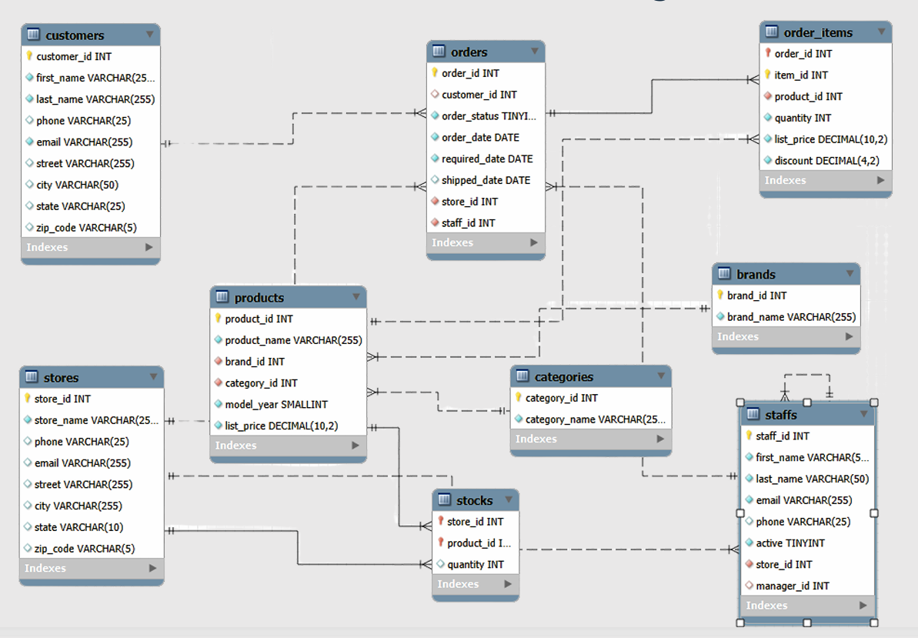
Relational Schema Diagram

Slide 5
AD-HOC Analysis
Sales Performance
Customer Insights
Product & Inventory
Staff & Store Efficiency

Slide 6

Sales Performance
Regions are most profitable per order
Output
SELECT s.state,
Round((ROUND(SUM(oi.quantity*(oi.list_price*(1-oi.discount))),2) ) / count(distinct oi.order_id) ,2) as avg_revenue_per_order
FROM jenkins.stores s
join orders o
on o.store_id=s.store_id
join order_items oi
on oi.order_id=o.order_id
group by state
order by avg_revenue_per_order desc
Actionable Suggestions:
Increase marketing efforts, open new stores, or expand distribution in top-performing states to maximize ROI.

Slide 7
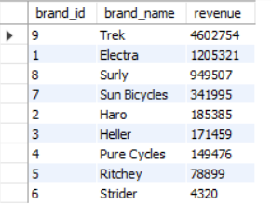
Sales Performance
Brands drive our revenue
Output
SELECT
b.brand_id,
b.brand_name,
Round(sum((oi.list_price*(1-oi.discount))*oi.quantity),0) as revenue
FROM
order_items oi
join products p
on oi.product_id=p.product_id
join
brands b on p.brand_id=b.brand_id
group by brand_name
order by revenue desc;
Actionable Suggestions:
Give top brands better shelf placement, run co-branded promotions, and negotiate strategic partnerships.

Slide 8
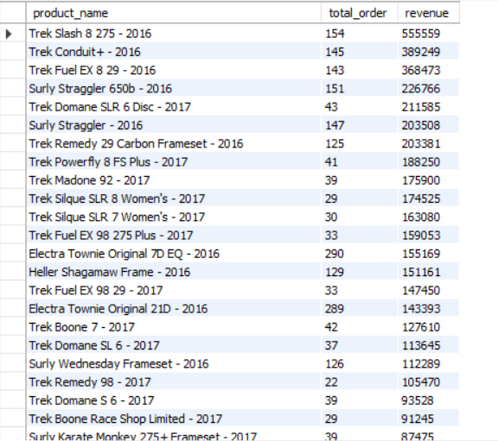
Sales Performance
Best sellers
Output
SELECT p.product_name, sum(oi.quantity) as total_order,
Round(sum((oi.list_price*(1-oi.discount))*oi.quantity),0) as revenue
FROM jenkins.order_items oi
join products p on p.product_id=oi.product_id
group by product_name
order by revenue desc;
Actionable Suggestions:
Feature high-revenue items in premium displays; bundle high-quantity items with accessories to increase upsell potential.

Slide 9

Sales Performance
Month which had the highest revenue overall
Output
SELECT o.order_id,
date_format(o.order_date, '%Y-%m') AS month,
Round(sum((oi.list_price*(1-oi.discount))*oi.quantity),0) as revenue
FROM jenkins.orders o
join order_items oi on oi.order_id=o.order_id
group by month
order by revenue desc
limit 1;
Actionable Suggestions:
Replicate successful strategies from that month (discounts, campaigns, product launches).

Slide 10
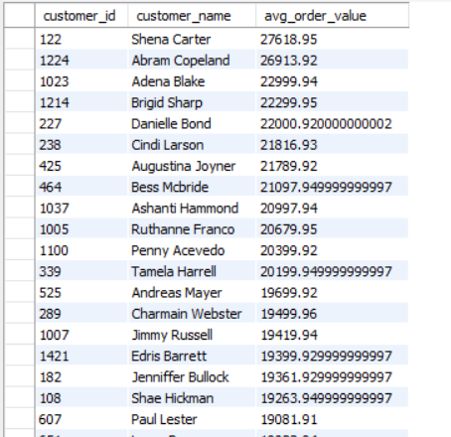
Customer Insights
Average order value is higher than the overall store average order value.
WITH order_totals AS (
SELECT o.order_id,
SUM(oi.quantity * oi.list_price) AS order_value
FROM orders o
JOIN order_items oi ON o.order_id = oi.order_id
GROUP BY o.order_id),
customer_avg AS (
SELECT
o.customer_id,
AVG(ot.order_value) AS avg_order_value
FROM order_totals ot
JOIN orders o ON ot.order_id = o.order_id
GROUP BY o.customer_id),
store_avg AS (
SELECT AVG(order_value) AS store_avg_value
FROM order_totals)
Output
SELECT
c.customer_id,
CONCAT(c.first_name, ' ', c.last_name) AS customer_name,
ca.avg_order_value,s.store_avg_value
FROM customer_avg ca
JOIN customers c ON ca.customer_id = c.customer_id
JOIN store_avg s ON 1=1
join orders o on o.customer_id=c.customer_id
WHERE ca.avg_order_value > s.store_avg_value
ORDER BY ca.avg_order_value DESC;
Actionable Suggestions:
Create a VIP / premium loyalty program with early access, exclusive bundles, or personalized offers.

Slide 11
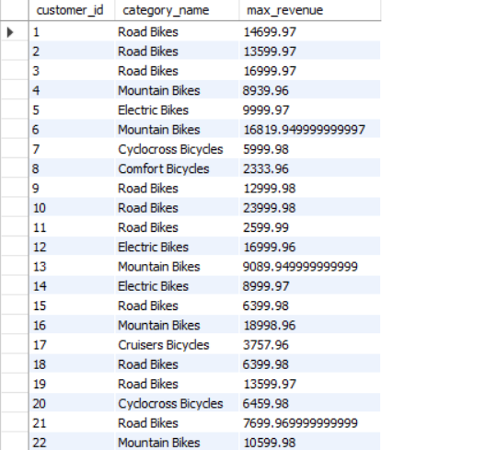
Customer Insights
Most valuable product category (highest revenue contributor) for each customer.
WITH category_revenue AS (
SELECT
c.customer_id,
ca.category_name,
SUM(oi.quantity * oi.list_price) AS revenue
FROM customers c
JOIN orders o ON c.customer_id = o.customer_id
JOIN order_items oi ON o.order_id = oi.order_id
JOIN products p ON p.product_id = oi.product_id
join categories ca on p.category_id=ca.category_id
GROUP BY c.customer_id, ca.category_name
),
ranked AS (
SELECT *,
RANK() OVER (PARTITION BY customer_id ORDER BY revenue DESC) AS rnk
FROM category_revenue
)
SELECT
customer_id,
category_name,
revenue AS max_revenue
FROM ranked
WHERE rnk = 1;
Output
Actionable Suggestions:
Run personalized category-based recommendations and cross-sell related products.

Slide 12

Customer Insights
Customers Who Bought From ALL Categories
Output
WITH cust_cat AS (
SELECT DISTINCT
c.customer_id,
CONCAT(c.first_name,'_',c.last_name) AS customer_name,
p.category_id
FROM customers c
JOIN orders o ON c.customer_id = o.customer_id
JOIN order_items oi ON o.order_id = oi.order_id
JOIN products p ON oi.product_id = p.product_id
),
category_count AS (
SELECT
customer_id,
customer_name,
COUNT(DISTINCT category_id) AS category_count
FROM cust_cat
GROUP BY customer_id, customer_name
),
total_cat AS (
SELECT COUNT(*) AS total_categories FROM categories
)
SELECT
cc.customer_id,
cc.customer_name,
cc.category_count
FROM category_count cc
CROSS JOIN total_cat tc
WHERE cc.category_count = tc.total_categories;
Actionable Suggestions:
Treat them as brand ambassadors with referral bonuses, exclusive offers, and product trials.

Slide 13

Customer Insights
Customer concentration based on states
Output
SELECT
state,
count(customer_id) as no_of_people
FROM
customers
group by state
order by no_of_people desc;
Actionable Suggestions:
Prioritize store openings, localized ads, and regional campaigns in top 3–5 states.

Slide 14
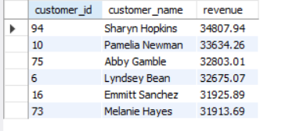
Customer Insights
Customers who have spent more than $30000 in total.
Output
SELECT c.customer_id,concat(c.first_name,' ',last_name) as customer_name,
Round(sum((oi.list_price*oi.quantity*(1-oi.discount))),2) as revenue
FROM orders o
Join customers c
on o.customer_id=c.customer_id
Join order_items oi
on oi.order_id=o.order_id
group by c.customer_id
having revenue>30000
order by revenue desc;
Actionable Suggestions:
Offer premium tiers, priority delivery, and dedicated support to retain them.

Slide 15

Customer Insights
Customers who are frequent vs infrequent, each group contributes to revenue
and their average order and spend behaviour
WITH customer_freq AS (
SELECT
c.customer_id,
COUNT(o.order_id) AS total_orders,
SUM(oi.list_price * oi.quantity * (1 - oi.discount)) AS total_spent,
CASE
WHEN COUNT(o.order_id) < 3
OR SUM(oi.list_price * oi.quantity * (1 - oi.discount)) < 4999
THEN 'infrequent buyers'
ELSE 'frequent buyers'
END AS cust_cat
FROM customers c
JOIN orders o
ON c.customer_id = o.customer_id
JOIN order_items oi
ON o.order_id = oi.order_id
GROUP BY c.customer_id
)
FROM customer_freq
GROUP BY cust_cat
ORDER BY total_revenue DESC;
SELECT
cust_cat,
COUNT(customer_id) AS total_customers,
ROUND(AVG(total_orders), 2) AS avg_orders_per_customer,
ROUND(AVG(total_spent), 2) AS avg_spent_per_customer,
ROUND(SUM(total_spent), 2) AS total_revenue
Output
Actionable Suggestions:
Frequent: give loyalty rewards. Infrequent: run reactivation campaigns and limited-time offers.

Slide 16
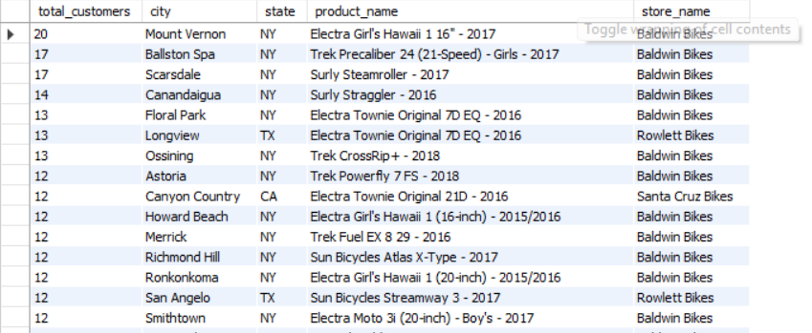
Customer Insights
Purchasing behaviour of customers from different regions
SELECT COUNT(distinct c.customer_id) AS total_customers, c.city,
c.state, p.product_name, st.store_name
FROM customers c
JOIN orders o
ON c.customer_id = o.customer_id
JOIN stores st
ON o.store_id = st.store_id
JOIN order_items oi
ON o.order_id = oi.order_id
JOIN products p
ON oi.product_id = p.product_id
GROUP BY c.city
ORDER BY total_customers desc;
Output
Actionable Suggestions:
Launch region-specific marketing and optimize inventory for top-selling items in each region

Slide 17
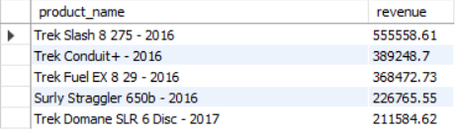
Product & Inventory
Top 5 products with the highest revenue.
SELECT jp.product_name,
Round(sum((ot.list_price*ot.quantity*(1-ot.discount))),2) as revenue
FROM jenkins.products jp
Join order_items ot
on jp.product_id=ot.product_id
group by jp.product_id
order by revenue desc
limit 5;
Output
Actionable Suggestions:
Highlight these products on store displays, online banners, and promote them through targeted digital campaigns.

Slide 18
Product & Inventory
Second highest revenue product.
select product_name, revenue from (
SELECT p.product_id,product_name,
Round(sum((oi.list_price*oi.quantity*(1-oi.discount))),2) as revenue ,
rank() over( order by Round(sum((oi.list_price*oi.quantity*(1-oi.discount))),2) desc ) as rak
FROM jenkins.products p
join order_items oi on p.product_id=oi.product_id
group by product_name) as t
where rak=2;
Output
Actionable Suggestions:
Use dynamic ranking in dashboards to monitor performance and adjust pricing or discounts for top-ranked items.

Slide 19
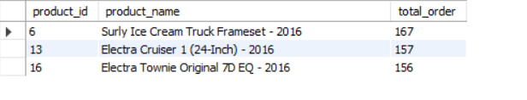
Product & Inventory
Top 3 best-selling products in terms of quantity.
SELECT p.product_id,
product_name,
sum(oi.quantity) as total_order
FROM jenkins.products p
join order_items oi
on p.product_id=oi.product_id
group by p.product_name
order by total_order desc
limit 3;
Output
Actionable Suggestions:
Bundle high-quantity items with accessories to increase average order value (AOV).

Slide 20
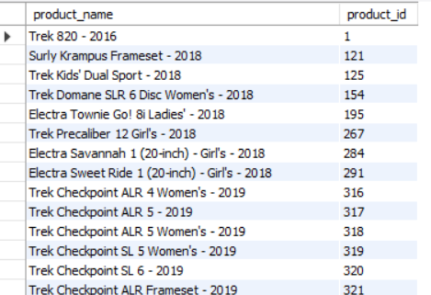
Product & Inventory
The products that have yet to be sold.
SELECT
p.product_name,
p.product_id
FROM products p
where not exists(SELECT * FROM order_items oi
where p.product_id=oi.product_id)
Actionable Suggestions:
Review product placement, revise pricing, promote through limited-time offers, or consider discontinuation.

Slide 21
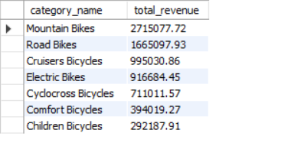
Product & Inventory
Total revenue generated from each product category
with cte1 as
(SELECT p.product_id,c.category_name as category_name,
Round(((oi.list_price*(1-oi.discount))*oi.quantity),2) as revenue
from order_items oi
join products p
on p.product_id =oi.product_id
join categories c
on c.category_id=p.category_id)
select category_name, round(sum(revenue),2) as total_revenue
FROM cte1
group by category_name
order by total_revenue desc
Output
Actionable Suggestions:
Increase inventory for top categories, prioritize supply chain flow, and plan category-specific campaigns.

Slide 22
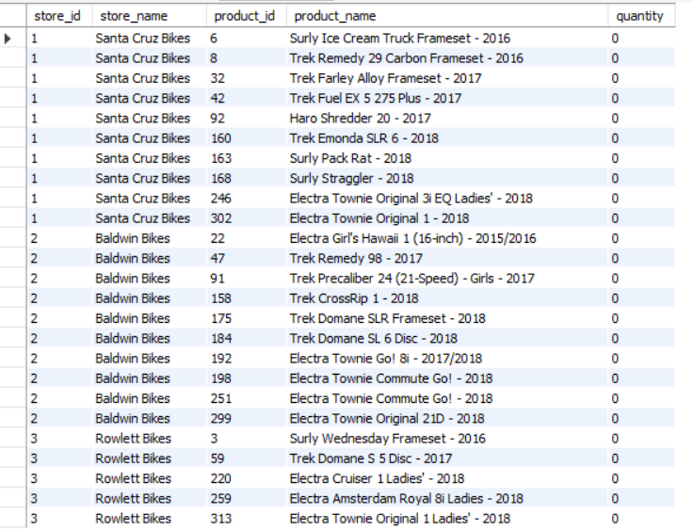
Product & Inventory
Products with low stock (quantity below a certain threshold).
Output
SELECT
st.store_id,
s.store_name,
p.product_id,
p.product_name,
st.quantity
FROM stocks st
join stores s
on st.store_id=s.store_id
join products p
on p.product_id=st.product_id
where quantity<1
Actionable Suggestions:
Trigger automated stock alerts, reorder immediately, and optimize safety stock levels.

Slide 23
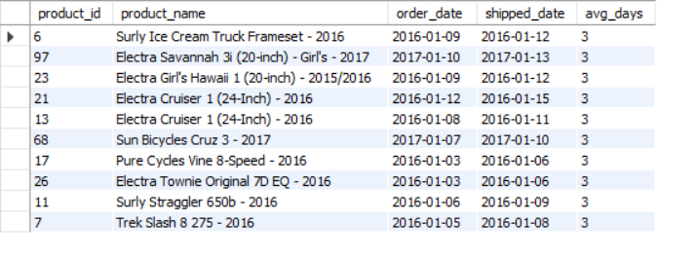
Product & Inventory
The average time between order placement and shipment for each product.
with avg_shipping as
(SELECT p.product_id,p.product_name,o.order_date,o.shipped_date,
datediff(o.shipped_date,o.order_date) as avg_days
from products p
join order_items oi
on oi.product_id=p.product_id
join orders o
on o.order_id=oi.order_id)
select * from avg_shipping
group by product_id
order by avg_days desc
limit 10;
Output
Actionable Suggestions:
Coordinate with suppliers or warehouses to reduce delays; consider priority shipping for slow-dispatch items.

Slide 24
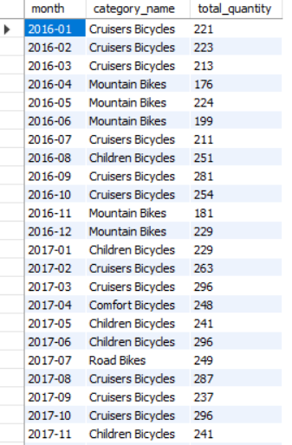
Product & Inventory
Most popular product category each month. (Use Window Function)
Output
select month,category_name,total_quantity from (
SELECT
date_format(o.order_date, '%Y-%m') AS month,
sum(oi.quantity) as total_quantity,
c.category_name,
rank() over(partition by date_format(o.order_date, '%Y-%m')
order by sum(oi.quantity) desc)as rak
FROM jenkins.orders o
join order_items oi on oi.order_id=o.order_id
join products p on p.product_id=oi.product_id
join categories c on c.category_id=p.category_id
group by month) as t
where rak=1
Actionable Suggestions:
Use month-wise insights to forecast inventory, plan seasonal promotions, and align stock before demand peaks.

Slide 25
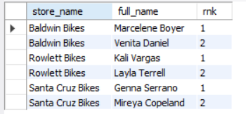
Staff & Store Efficiency
Staff performance across each store based on orders
SELECT
st.store_name,
sf.first_name || ' ' || sf.last_name AS full_name,
DENSE_RANK() OVER (
PARTITION BY st.store_name
ORDER BY COUNT(*) DESC
) AS rnk
FROM orders AS o
JOIN staffs AS sf ON sf.staff_id = o.staff_id
JOIN stores AS st ON st.store_id = o.store_id
GROUP BY st.store_name, sf.staff_id
ORDER BY st.store_name, rnk
Output
Actionable Suggestions:
Recognize high performers, assign them high-impact sales tasks, and use them as mentors to train low-performing staff.

Slide 26
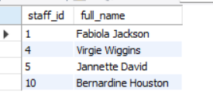
Staff & Store Efficiency
Staff Members Who Have Not Made Any Sales
Output
SELECT sf.staff_id,
concat(sf.first_name,' ',sf.last_name )AS full_name
FROM jenkins.staffs sf
left join orders o
on o.staff_id=sf.staff_id
where o.order_id is null;
Actionable Suggestions:
Provide additional sales training, review role suitability, or pair them with strong performers for guided improvement.

Slide 27

Staff & Store Efficiency
Staff with Sales Above Average
WITH cte1 AS (
SELECT
st.staff_id,
CONCAT(st.first_name, ' ', st.last_name) AS full_name,
ROUND(SUM((oi.list_price * (1 - oi.discount)) * oi.quantity), 0) AS revenue
FROM jenkins.order_items oi
JOIN orders o ON o.order_id = oi.order_id
JOIN staffs st ON o.staff_id = st.staff_id
JOIN stores s ON o.store_id = s.store_id
GROUP BY st.staff_id, st.store_id
),
avg_total AS (
SELECT AVG(revenue) AS avg_revenue FROM cte1
)
SELECT
c.staff_id,
c.full_name,
c.revenue,
ROUND(av.avg_revenue, 0) AS average_revenue
FROM cte1 c
CROSS JOIN avg_total av
WHERE c.revenue > av.avg_revenue
ORDER BY c.revenue DESC;
Output
Actionable Suggestions:
Reward high performers, and analyze their selling methods to replicate successful strategies across the team.

Slide 28
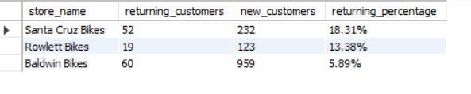
Staff & Store Efficiency
Customers are new and how many are returning via a subquery
SELECT
store_name,
COUNT(CASE WHEN status = 'returning' THEN 1 END) AS returning_customers,
COUNT(CASE WHEN status = 'new' THEN 1 END) AS new_customers,
concat(ROUND(
100.0 * (COUNT(CASE WHEN status = 'returning' THEN 1 END) )
/ COUNT(*),
2
),'%') AS returning_percentage
FROM (
SELECT
cu.customer_id,
s.store_name,
CASE
WHEN COUNT( o.order_id) > 1 THEN 'returning'
ELSE 'new'
END AS status
FROM customers cu
JOIN orders o ON o.customer_id = cu.customer_id
JOIN stores s ON s.store_id = o.store_id
GROUP BY
cu.customer_id,store_name
) as customer_status_by_store
GROUP BY
store_name
ORDER BY
ROUND(
100.0 * COUNT(CASE WHEN status = 'returning' THEN 1 END)
/ COUNT(*),
2
) DESC
Output
Actionable Suggestions:
Strengthen loyalty programs in low-retention stores; create personalized follow-ups and exclusive offers for repeat customers.

Slide 29
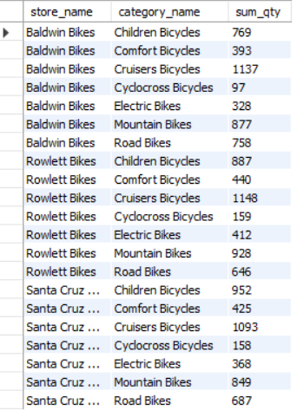
Staff & Store Efficiency
Number of stocks based on category name and store name
Output
Select st.store_name, c.category_name,
SUM(s.quantity) as sum_qty
from categories c JOIN products p
ON c.category_id = p.category_id
JOIN stocks s
ON p.product_id = s.product_id
JOIN stores st ON
st.store_id = s.store_id
GROUP BY st.store_name, c.category_name
ORDER BY st.store_name, c.category_name;
Actionable Suggestions:
Balance inventory based on store demand trends: reduce overstock, increase quantities for high-demand categories.

Slide 30

THANK YOU
PRESENTED BY:
Gowri Abbigeri
Thanks for taking the time to review this work. The findings support better decisions across customers, staff, inventory, and store operations.

